Slide 1



COMMIT
Customer Experience: Go to Market Strategy and Distribution
www.startupnv.org

Slide 2
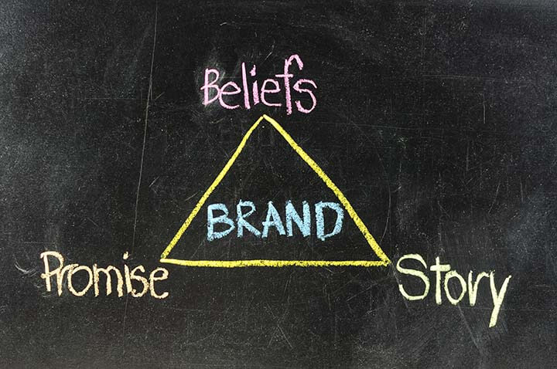
COMMIT – Reaching the Market
What do I want my brand to communicate?
How best to communicate that message?
Spreading the word…
Your “Brand Identity & Promise”

Slide 3
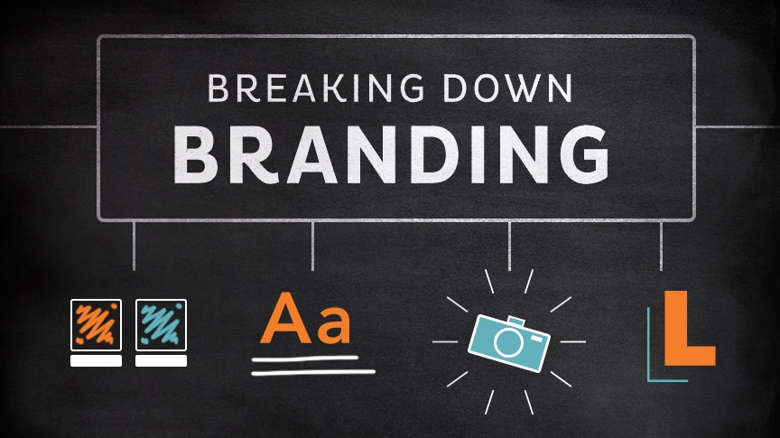
COMMIT – Creating a Brand
Inputs & Considerations
Target Customer Alignment
Brand Values
Brand Promise(s)
Points of Contact
Longevity

Slide 4
COMMIT – Picking a Brand Name
Consider these elements
Names of Competitors: Should distinguish the business from others
Message it Communicates: Consistent with business image
Uses of the Name: Primarily written or spoken
Domain Name Availability: Online presence options
Business Description: To reflect or not (i.e. Holiday Inn vs. Amazon)
Registration and Trademarks: Company marks are IP to be protected

Slide 5

COMMIT – Communicating Your Brand Promise
"What Do You Want Your Customers To Experience?"

Slide 6
COMMIT – Developing a Marketing Strategy
The “Positioning Statement”
What the product/service is
Why it’s special
The Target market
The Competitive landscape
The Competitive advantage
The Brand promise

Slide 7
COMMIT – Selecting Marketing Channels
Marketing Mix
The “5 Ps”
Product – What you make or provide
Place - Where you sell
Price – What someone is willing to pay
Promotion – How someone hears about it
People – Who customers interact with
Promotional Strategies
Advertising
Publicity
Events
Content

Slide 8
COMMIT – Selecting Marketing Channels
4 Channel Categories
Digital: Website; Email; Search; Social Media; Online Ads; Webinars; Video; Podcast
Print: Biz Cards; Flyers; Direct Mail; Brochures
Traditional: Publications; Signage; Billboards; Broadcast
Events: Networking; Community; Trade Shows; In Store

Slide 9
COMMIT – Selecting Marketing Channels
The Customer Journey
Problem - customer realizes unmet need or desire
Awareness - they hear that your offering might meet their need
Consideration - they research your offering against others for fit
Purchase – they decide to buy and become a customer
Advocacy – provided a good experience, they spread the word

Slide 10

COMMIT – Digital Marketing

Slide 11
COMMIT – Designing Marketing Materials
The Focus of Brand Design:
Relevance – Does the design communicate the essence of the brand and what it stands for?
Consistency – Are the elements of the brand used consistently?
Professionalism – Do the materials meet the expectations of the target audience and how they view good branding?
Brand Identity

Slide 12
COMMIT – Getting Your Customers’ Attention
“The Rule of 7”
States that a prospect needs to hear or see an advertiser’s message at least 7 times before they take action to buy
Tell a (Brand) Story
“Make it simple. Make it memorable. Make it inviting to look at. Make it fun to read.”

Slide 13
COMMIT – Distribution & Sales
The method companies use to sell and deliver products or services to their target market and the means by which they are distributed.
Distribution Analysis
Where and how does the target market shop for similar products/services?
What distribution channels do top competitors use?
What new distribution channels are being used in the industry?
What other distribution channels are being used successfully in other industries that may have impact here?
What typical barriers or challenges for entering new distribution channels are foreseen?
How effective is the current selling method in meeting future goals (ex: in-house staff or intermediaries)?
What distribution channel strategies might be used to accomplish these goals?

Slide 14
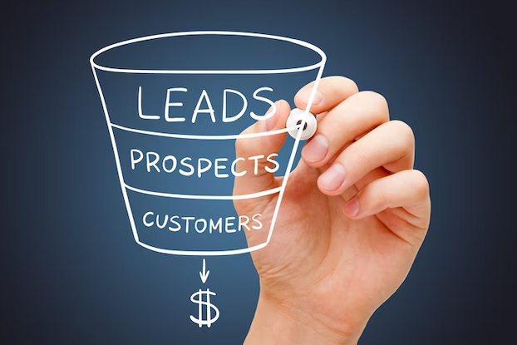
COMMIT – Distribution & Sales
“Always Be Selling”
Bottom line success in business hinges on sales execution.
4-Stage Selling Process
Selecting the Target
Engaging the Prospect
Making the Match
Doing the Deal

Slide 15
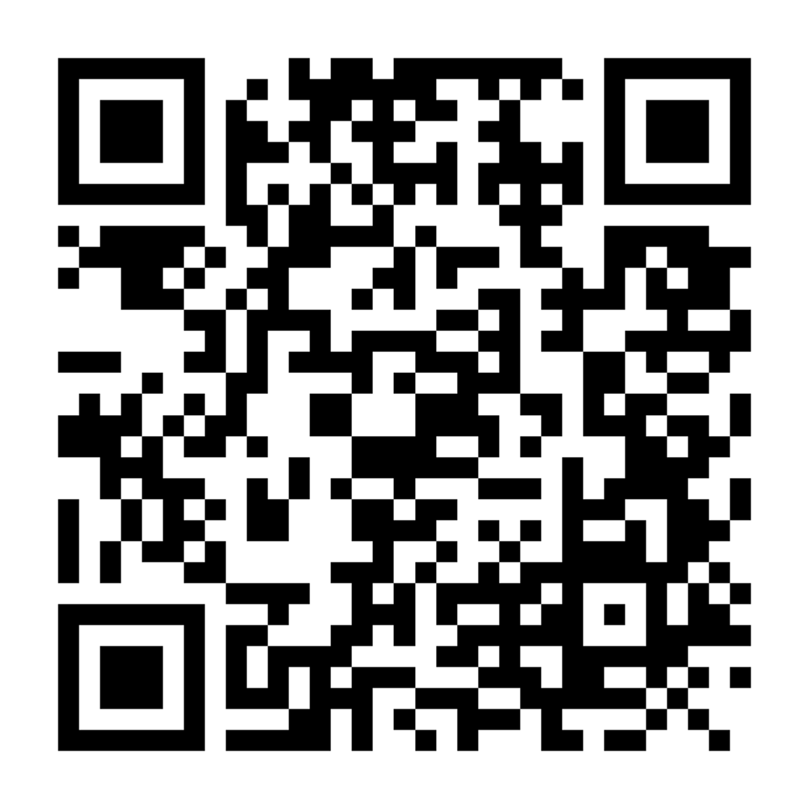
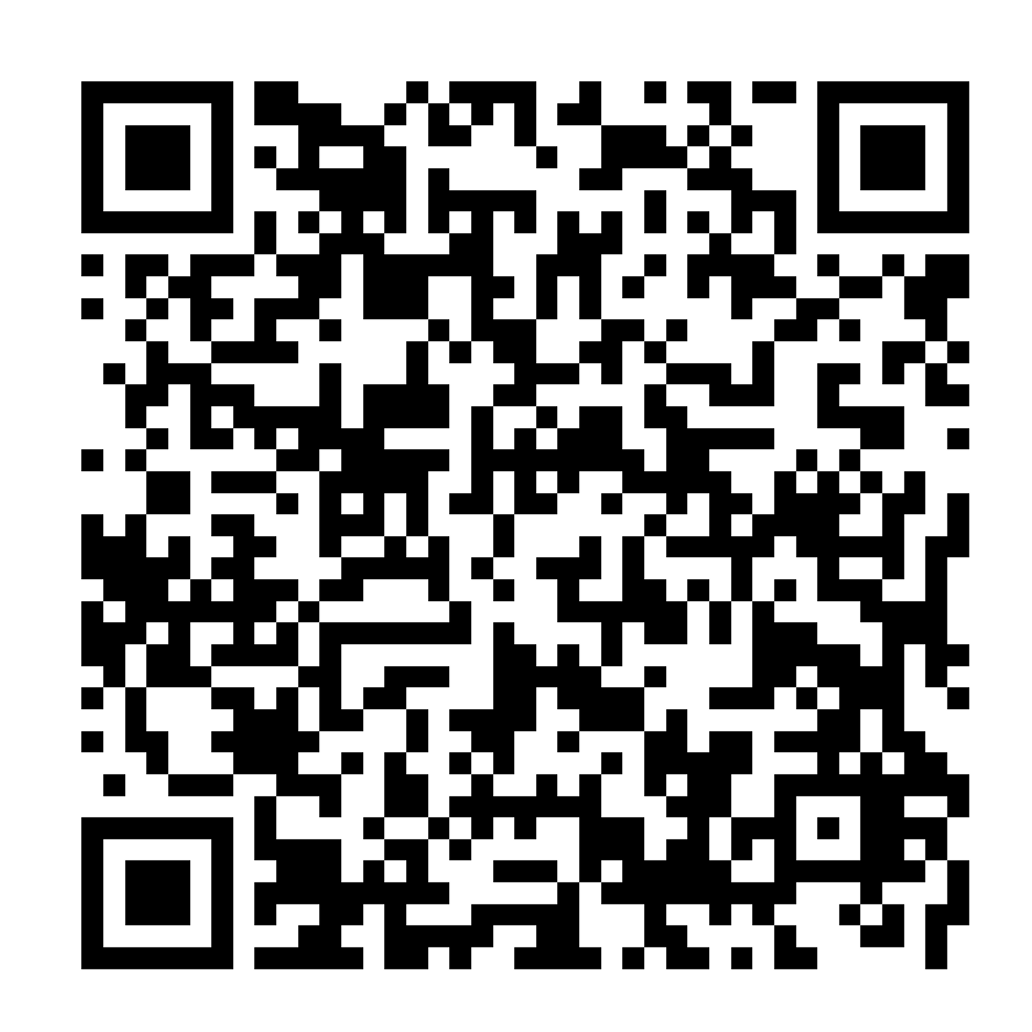
Thank you!
Slack Channel
Check-in for Today!

Slide 16

Next Week
Commit - Sales and Financials

